Slide 1

EMPLOYEE
PAYROLL SYSTEM
PRESENTED BY MIHIR UGHADE

Slide 2

INTRODUCTION
An Employee Payroll System is a software solution designed to automate and manage the financial records of employees. This system allows for efficient handling of salary payments, deductions, bonuses, taxes, and other payroll-related transactions. It simplifies the payroll process by ensuring accuracy, transparency, and timely payment to employees, reducing the likelihood of human errors associated with manual payroll management.

Slide 3





OBJECTIVES
Update Payroll Records.
Generate Pay Slips.
Generate Payroll Reports.

Slide 4
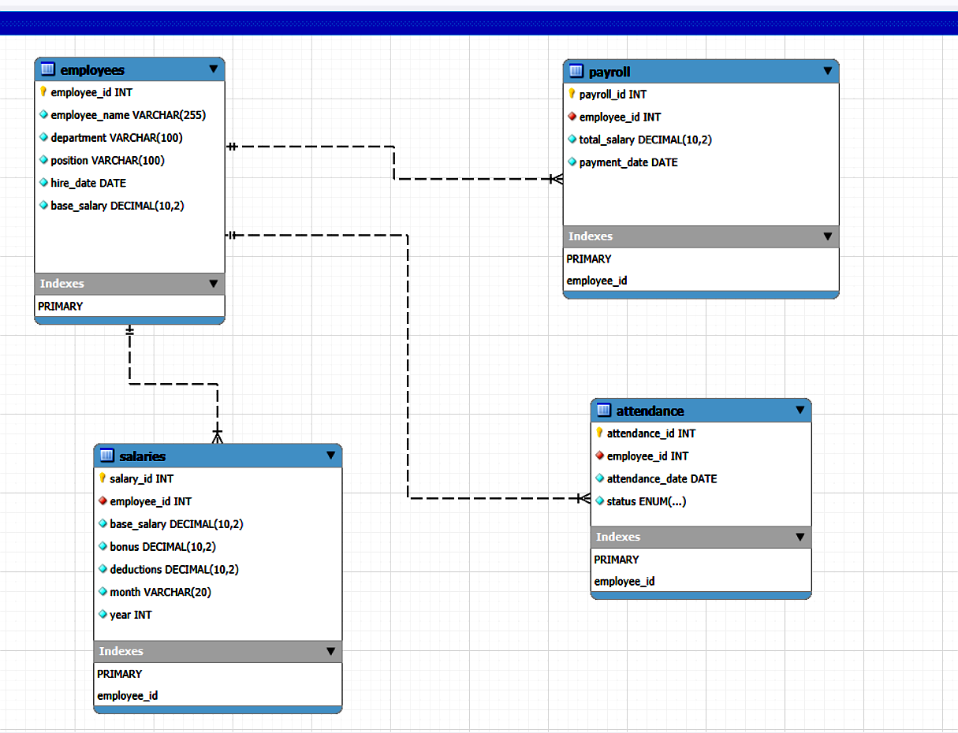
EER DIAGRAM

Slide 5
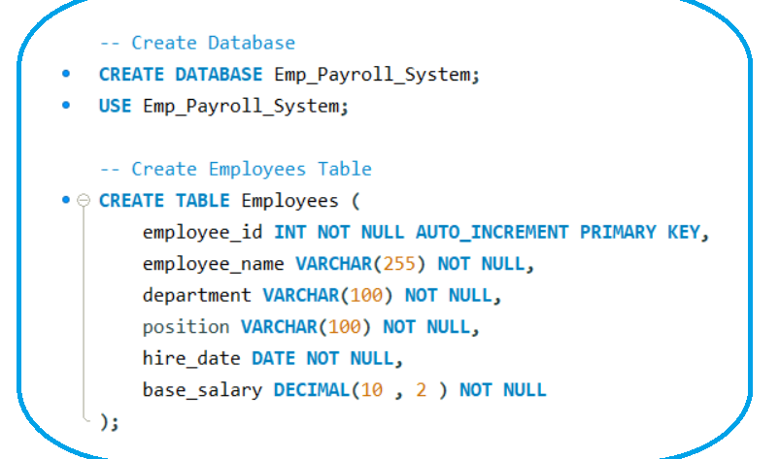
MYSQL SCHEMA DESIGN

Slide 6
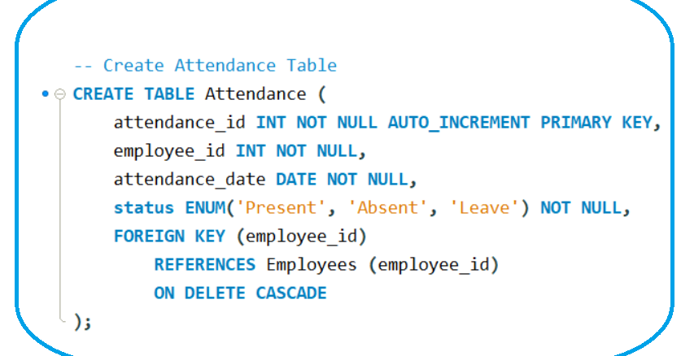

Slide 7
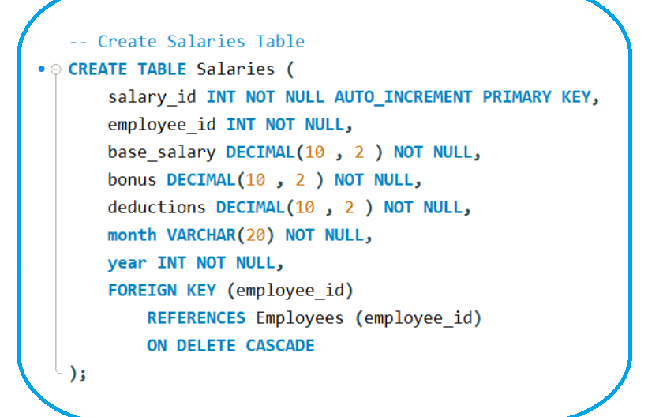

Slide 8
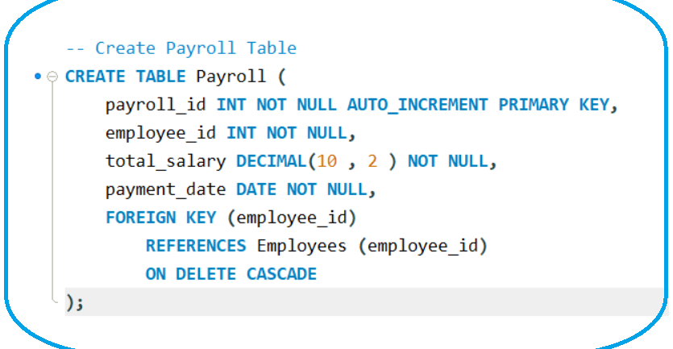

Slide 9


KEY INSIGHTS FROM THE PAYROLL SYSTEM
Employee Salary Trends
The highest salary is 58,000 (Maintenance Manager).
The lowest salary is 30,000 (Sales Executive).
Employees in managerial positions earn significantly higher than specialists or executives.
Attendance & Absenteeism Patterns
3 out of 10 employees were absent on September 1st, 2025.
2 employees were on leave, which may indicate
planned absences.
Attendance tracking is crucial for payroll calculations to
avoid overpayment or salary deductions.
Payroll & Salary Processing
Payroll calculations are dynamic, considering base salary, bonuses, and deductions.
Example: An employee earning 50,000 with a 5,000 bonus and 1,000 deduction gets a final salary of 53,000.
Automating payroll can reduce human errors and ensure accurate salary processing.

Slide 10


Deductions & Bonus Trends
The average bonus across employees is around 3,500.
Deductions are consistent at 1,000, meaning salary variations are mainly due to bonuses.
Introducing performance-based bonuses could help in employee motivation and retention.
Department-Wise Salary Insights
Maintenance & Operations departments have the highest salaries.
Sales & Marketing roles have lower base salaries but can be improved with commission-based incentives.

Slide 11
Questions Based on the Employee Payroll System Code
1️.) Database Structure:
What are the key tables used in the Employee Payroll System, and how are they related?
2️.)Data Integrity:
How does the use of foreign keys ensure data consistency in the payroll system?
3.) Payroll Processing:
How is the total salary calculated for an employee, and which factors affect it?
4️.) Attendance Management:
How does the system track employee attendance, and how can HR generate an attendance summary?
5️.) Employee Management:
What SQL query would you use to increase an employee's base salary by 10%?
6️.)Performance & Deductions:
How can the system identify employees with the most leaves or deductions in a given month?
7️.) Reporting & Insights:
Which query generates a yearly salary report, and what insights can be derived from it?
8️.) Error Handling & Constraints:
Why does deleting an employee with an existing attendance record result in an error (Error Code: 1451), and how can this be resolved?

Slide 12

Thank you very much!
PRESENTED BY MIHIR UGHADE

